Slide 1
Power BI
DAX Queries

Slide 2


Slide 3


Slide 4
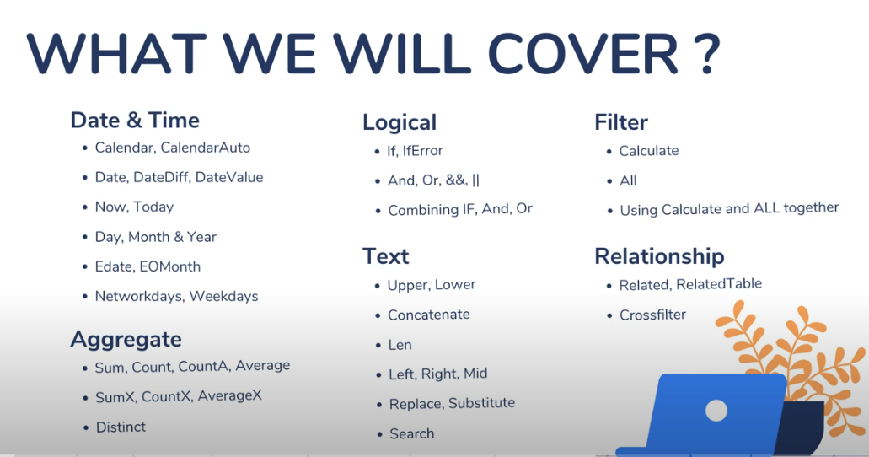

Slide 5


Slide 6


Slide 7
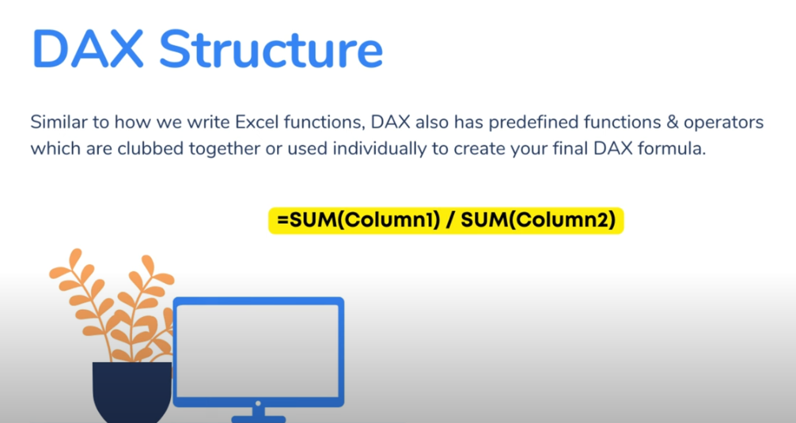

Slide 8
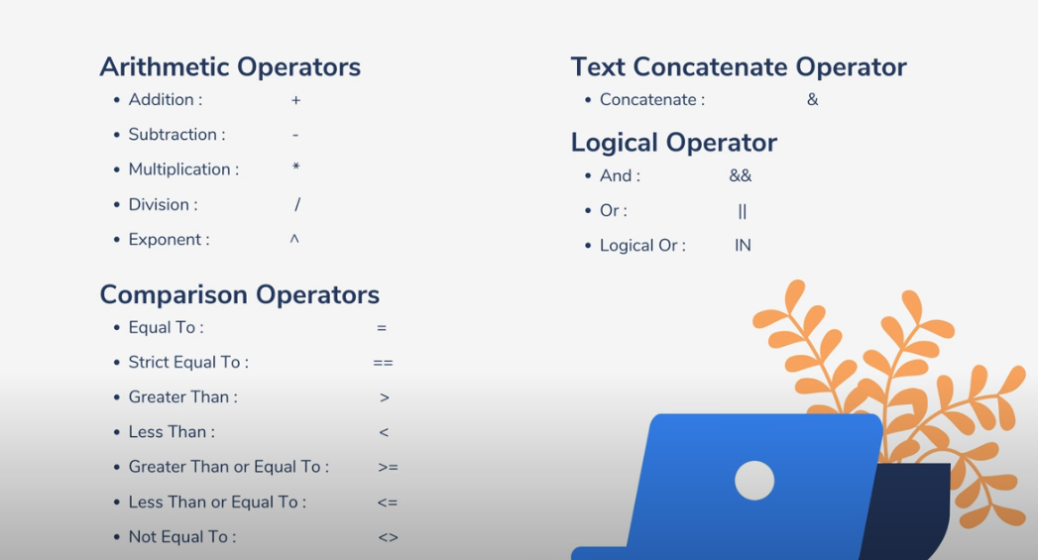

Slide 9
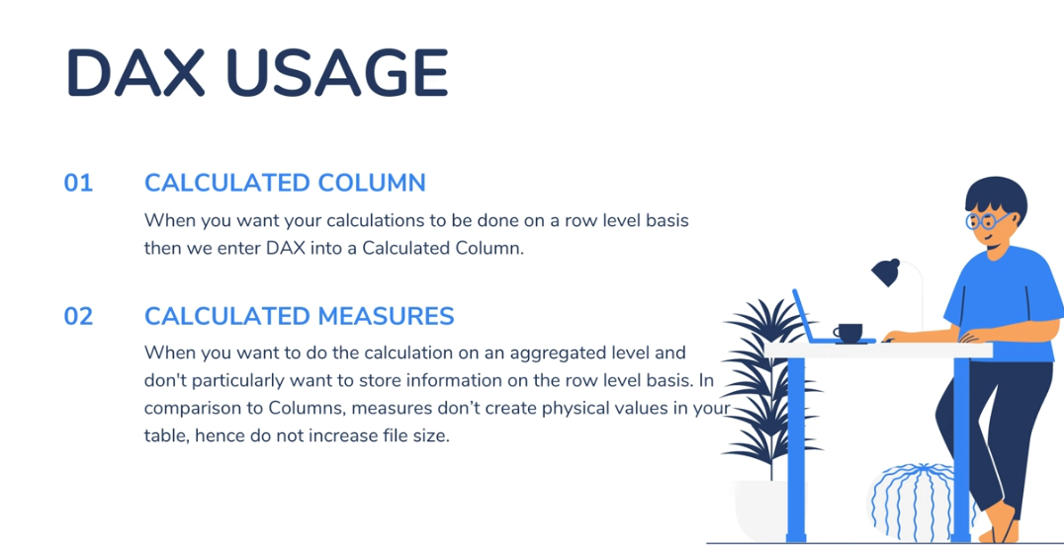

Slide 10
DAX Hands on
How to Create a Calculated Column

Slide 11
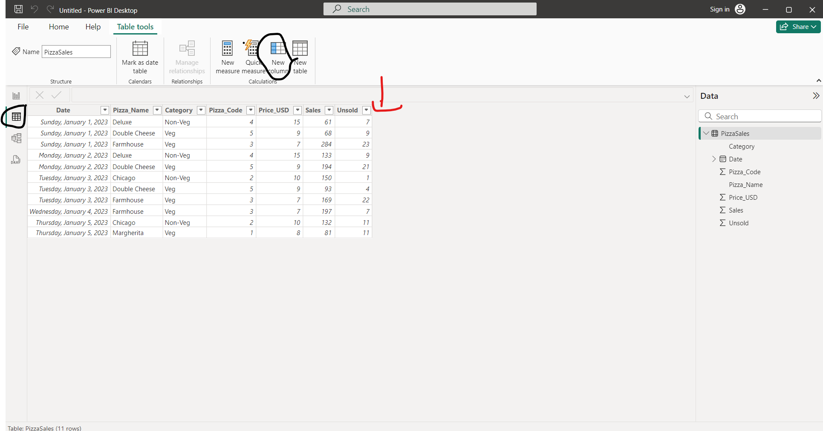
Create a revenue field by adding a new column

Slide 12
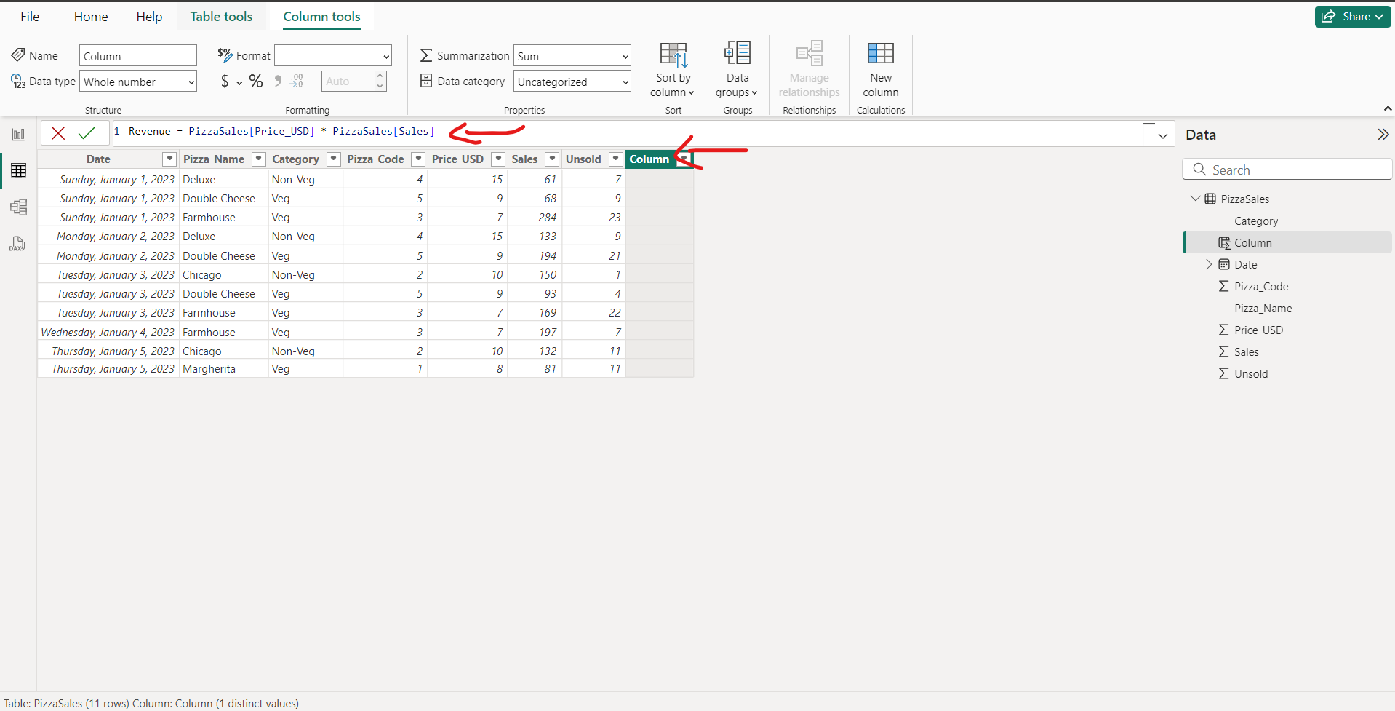
Query Editor write your query formula for Revenue and press Enter

Slide 13
Dax Structure
Table Name
Column Name
Multiplication

Slide 14
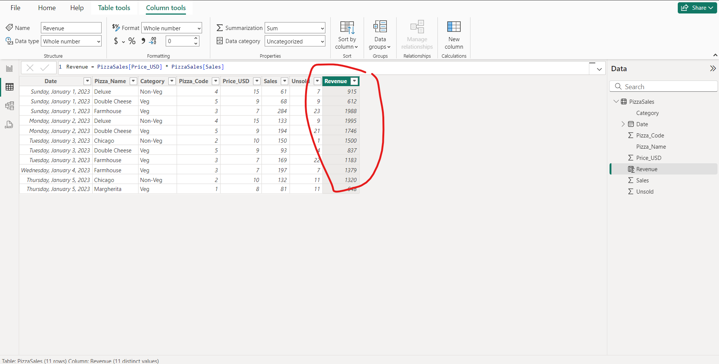
After you press “Enter” Revenue column would be generated with exact calculations

Slide 15
DAX Hands on
How to find Calculated Measure

Slide 16
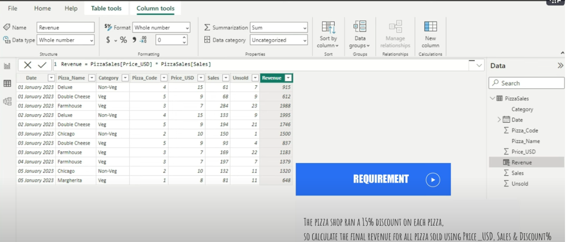
Req: The Pizza Shop ran a 15% discount on each pizza so calculate the final revenue for all pizza sold using Price_USD, Sales and Discount

Slide 17
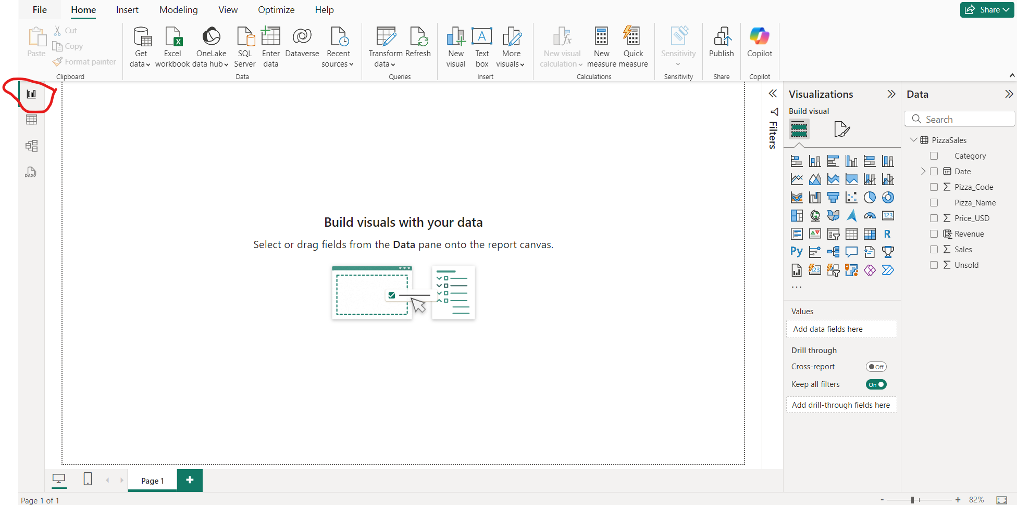
To calculate the “Req” goto report view

Slide 18
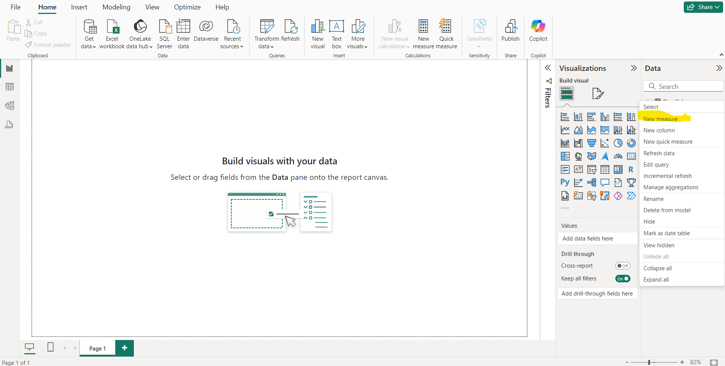
Goto New Measure

Slide 19
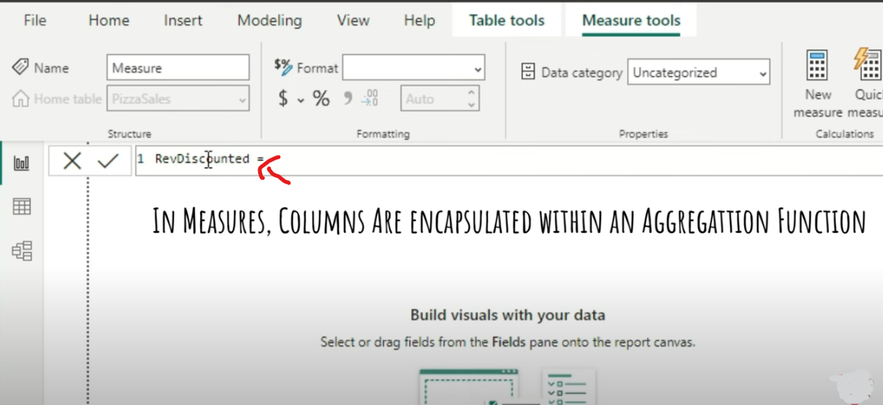
You need to write an aggregation function

Slide 20
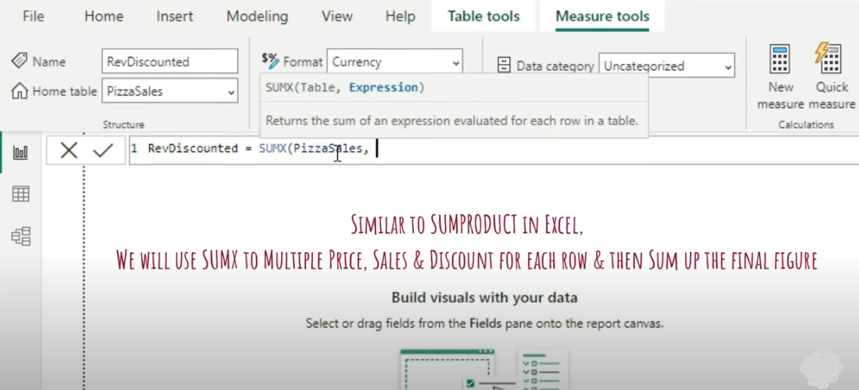
Sumx Formula

Slide 21
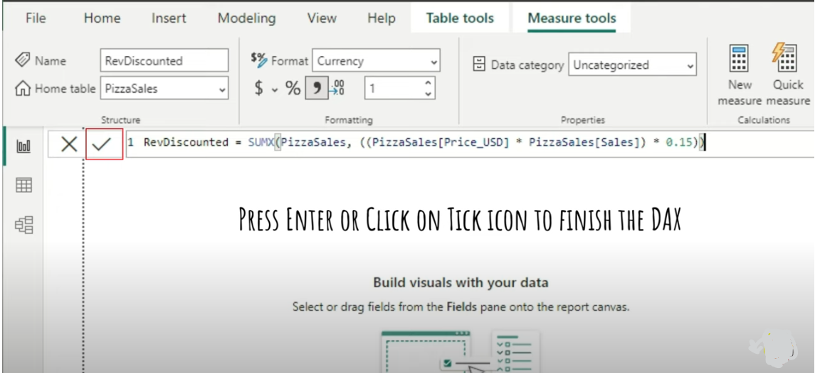
Calc Discounted Revenue Price

Slide 22


Slide 23
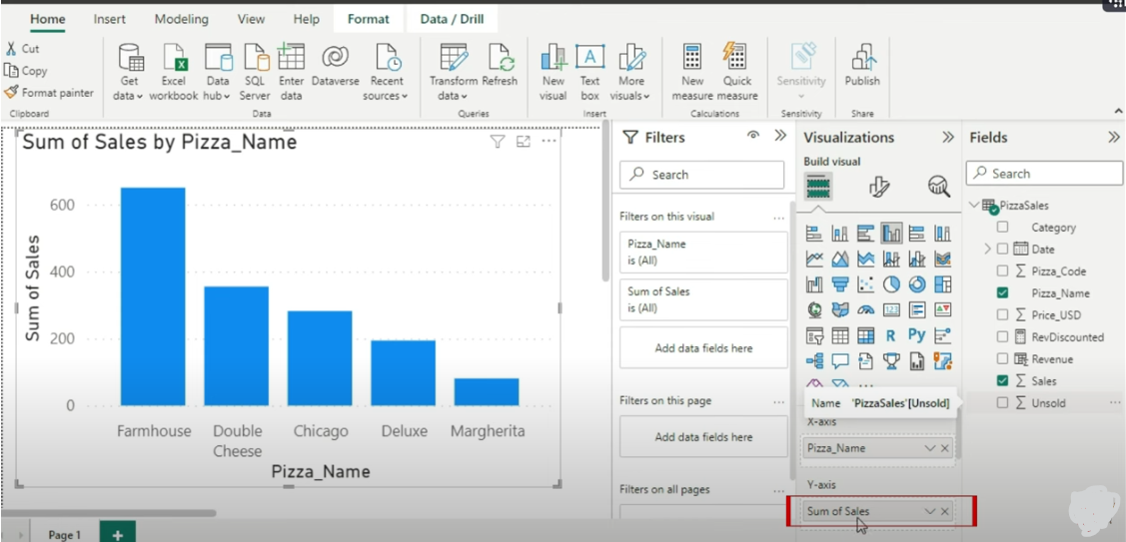
Implicit Example

Slide 24


Slide 25


Slide 26
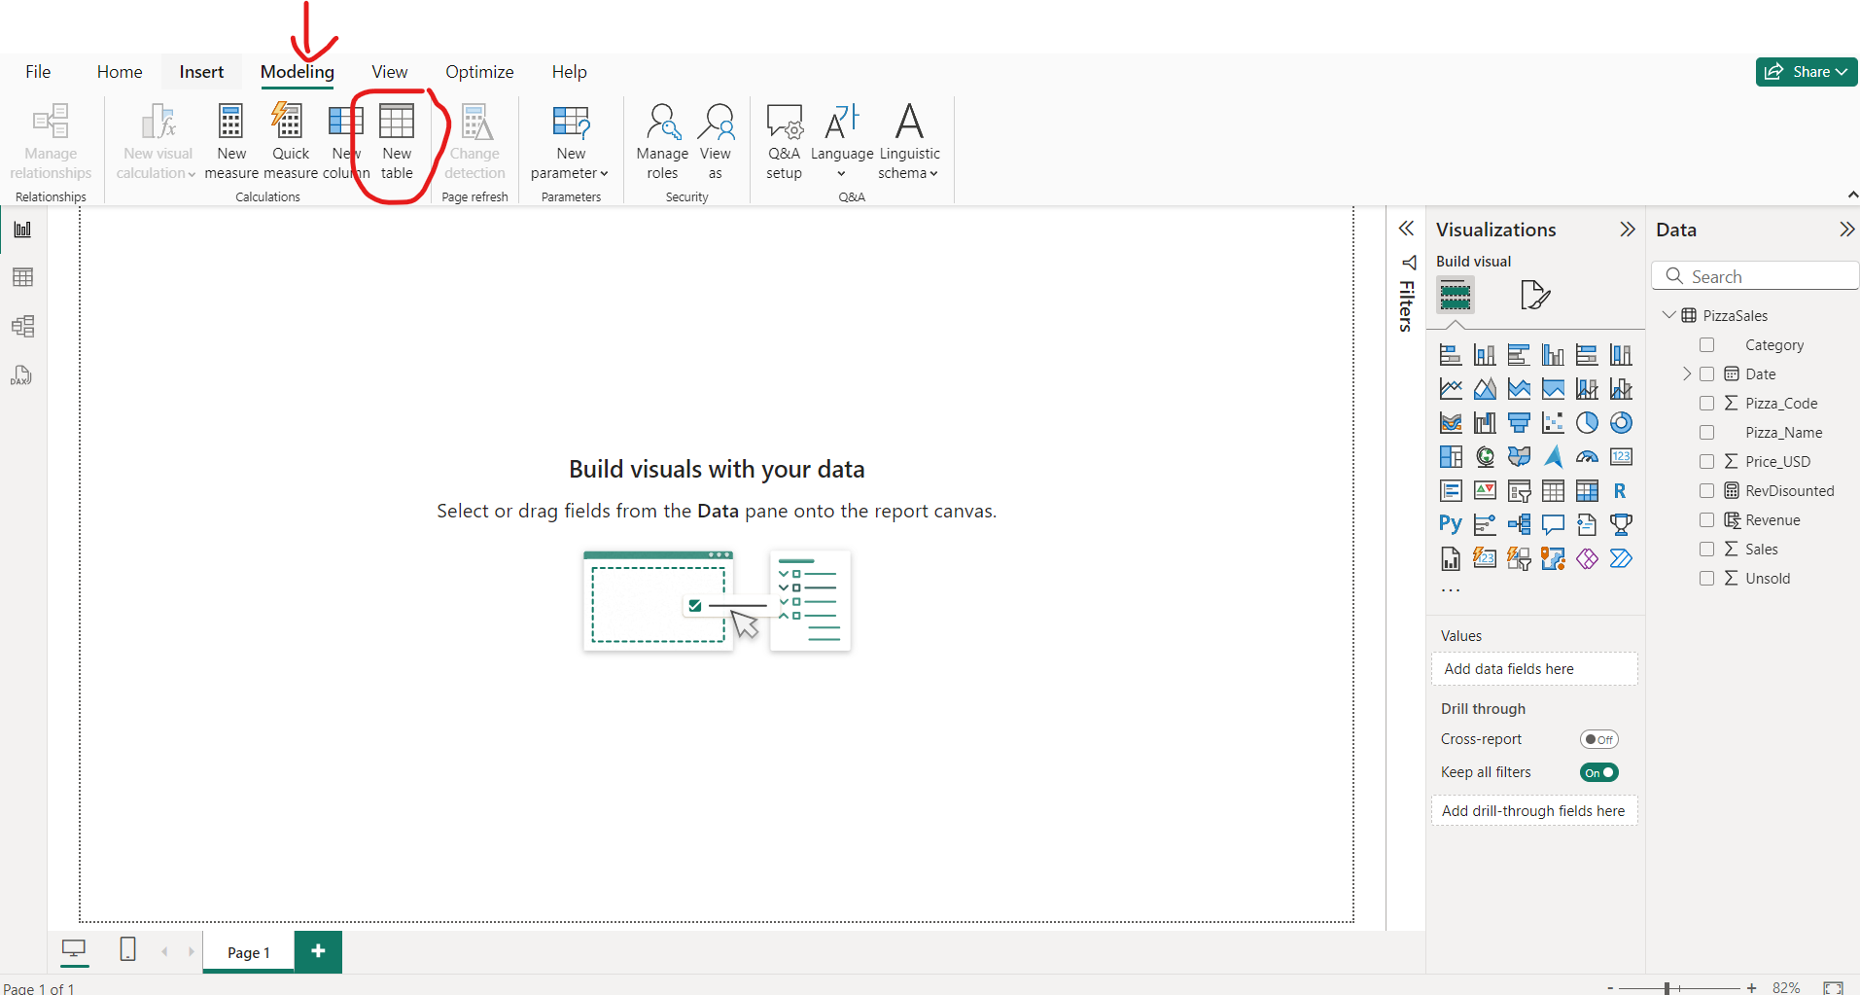

Slide 27
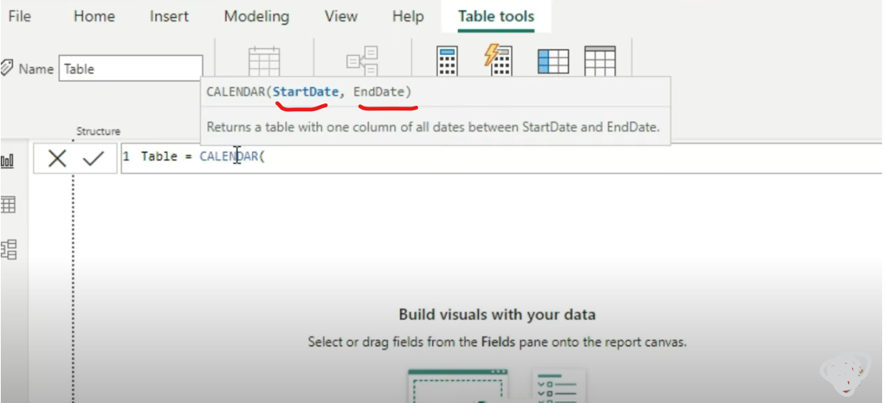
Create A Table Having a Calender Column Recording all your Start and End Dates

Slide 28
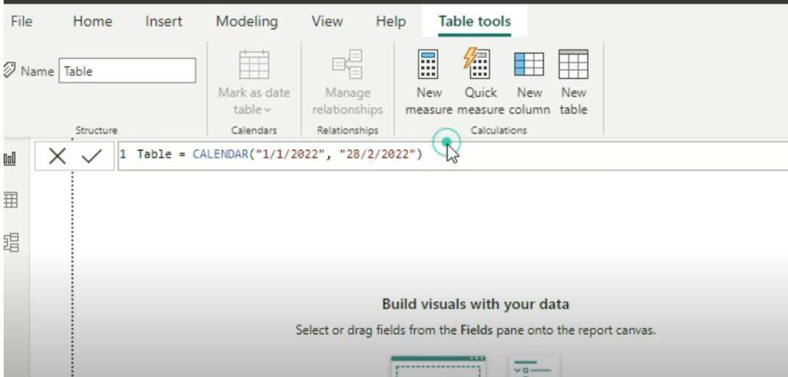
Give a Start and Ending Date

Slide 29
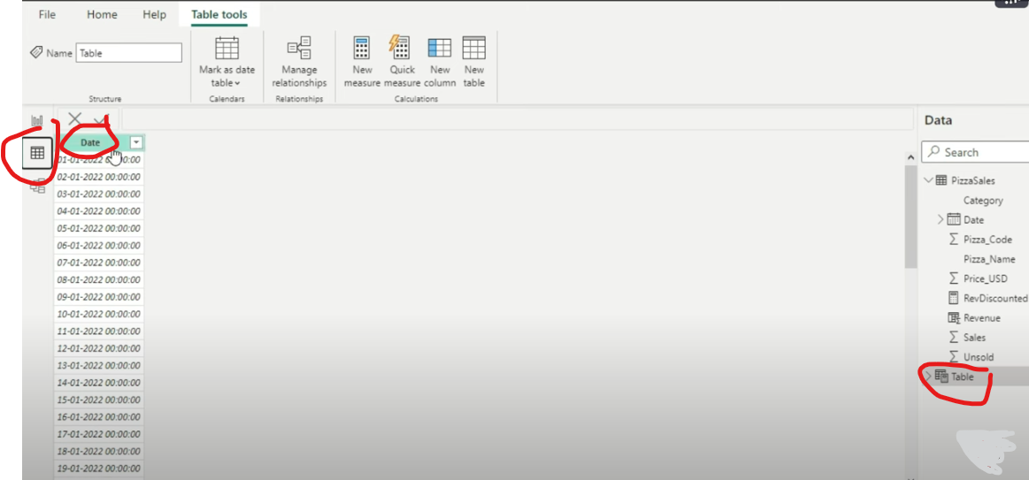
Press Enter and Goto Tabular View

Slide 30
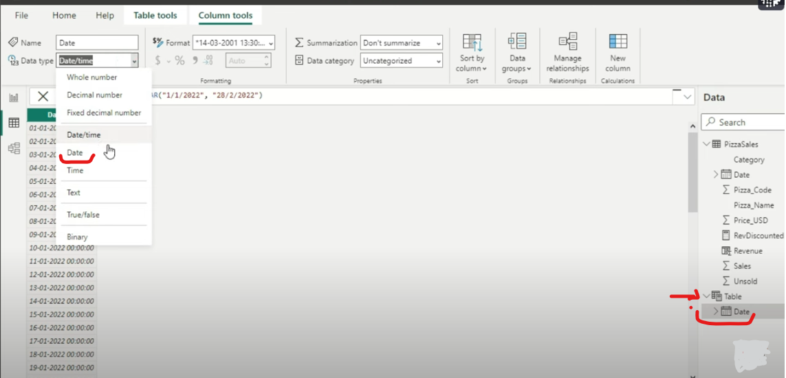
Format the date

Slide 31
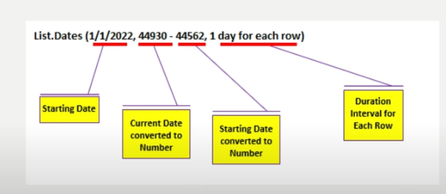

Slide 32
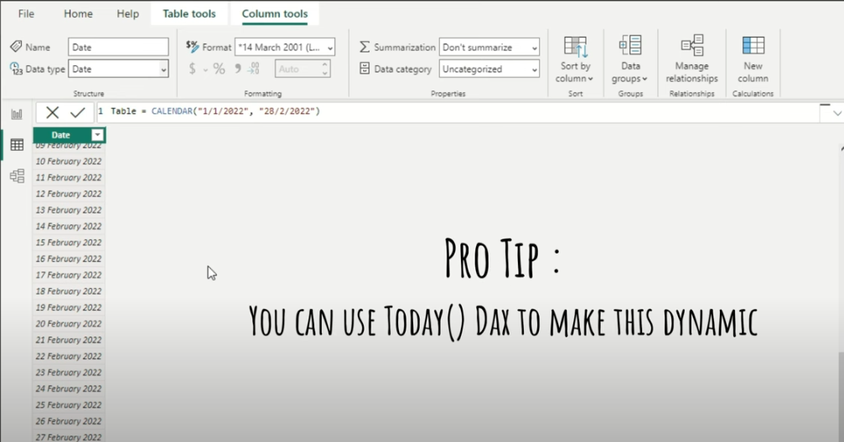
Date format

Slide 33
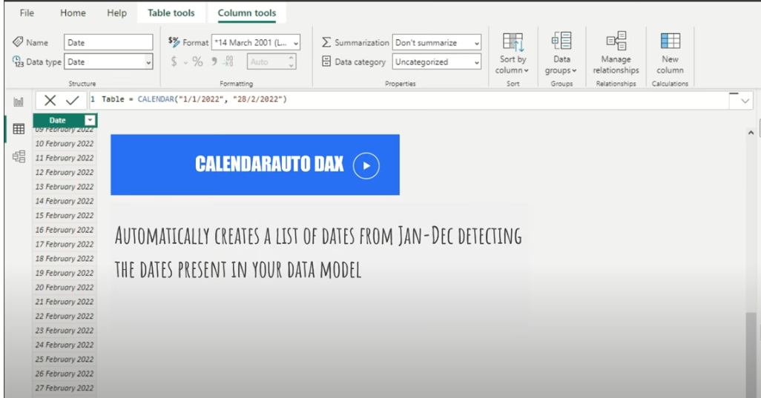
Calendar Auto Dax

Slide 34
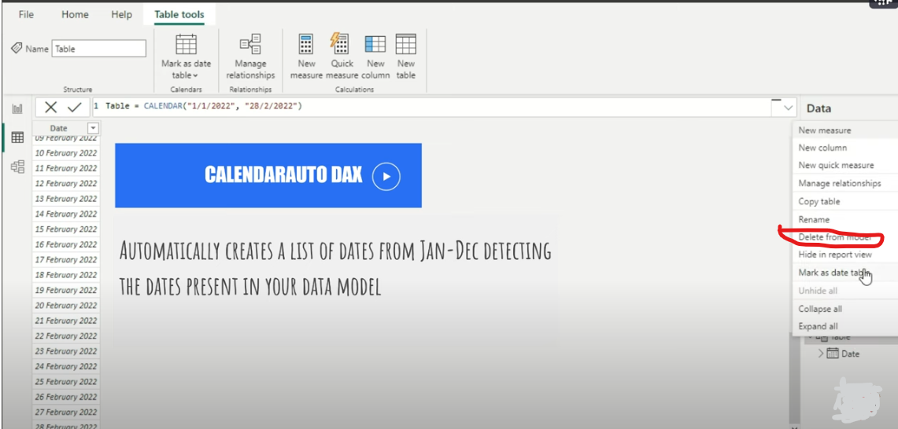
Delete the table

Slide 35
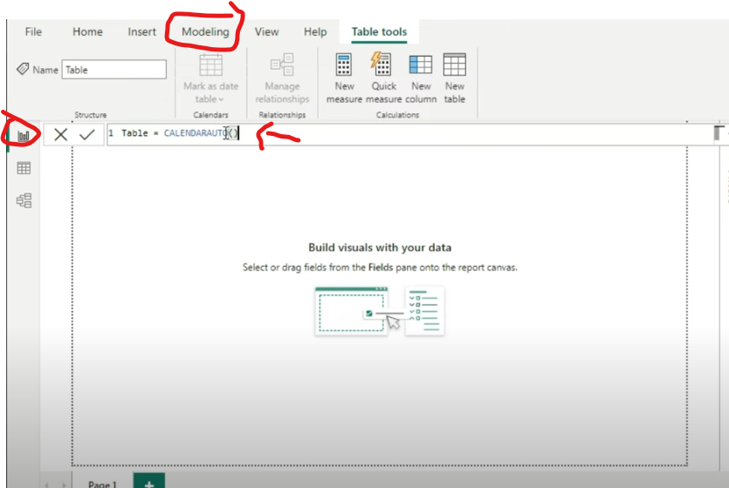
Create a table applying CalenderAuto Function

Slide 36
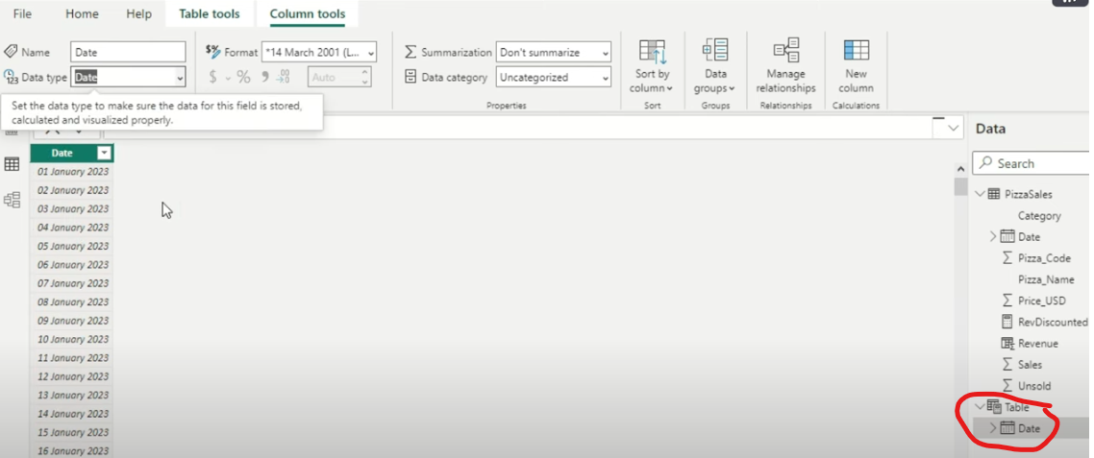
“CalenderAuto” Creates a list of date that is entirely present in your PizzaSales table

Slide 37
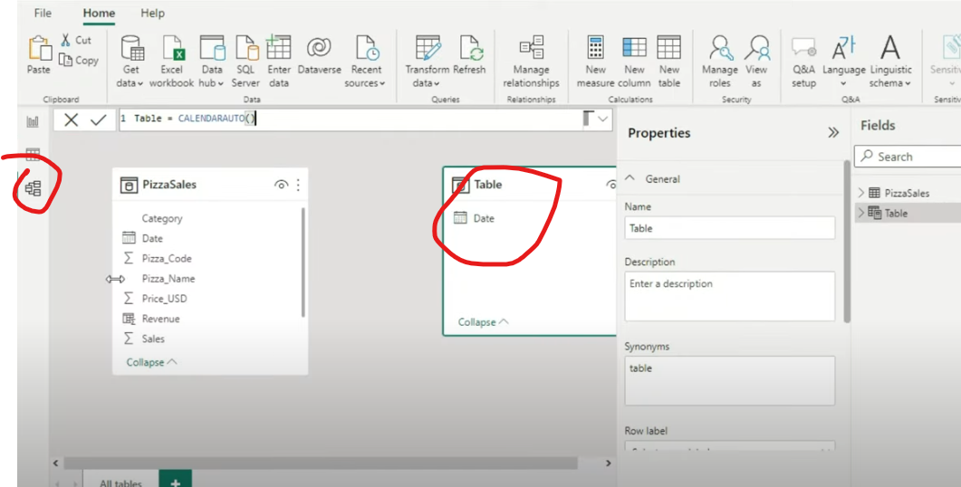
Model View

Slide 38
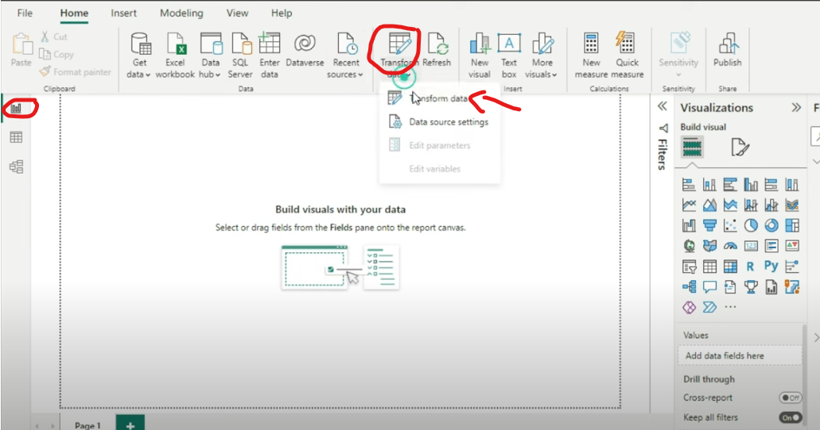
Goto Report -> Transform-> Transform Data

Slide 39
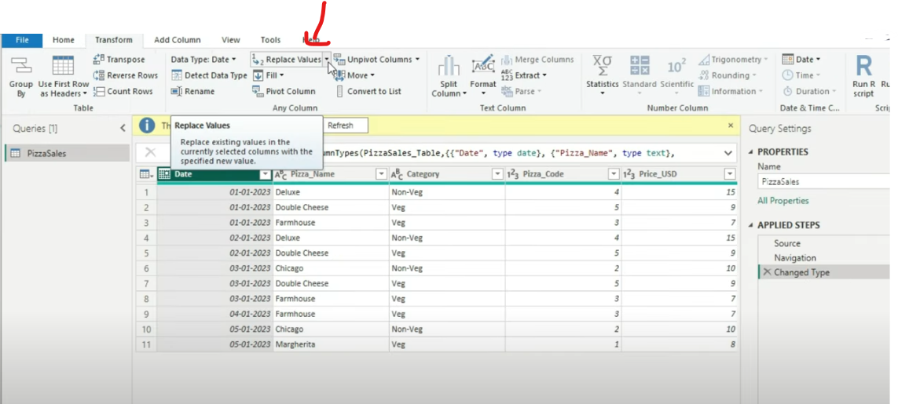
Replace Values of dates ranges

Slide 40
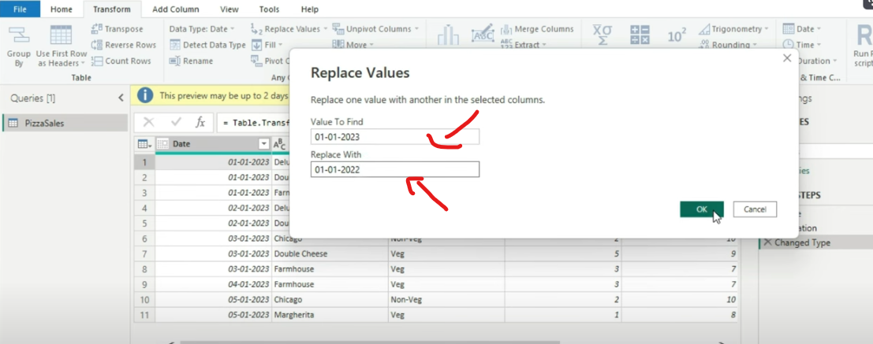
Replace Values

Slide 41
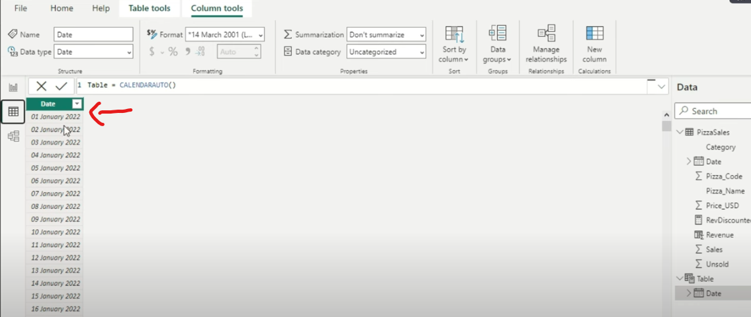
Now After Replacing the date is Starting from 1st of Jan 2022

Slide 42


Slide 43
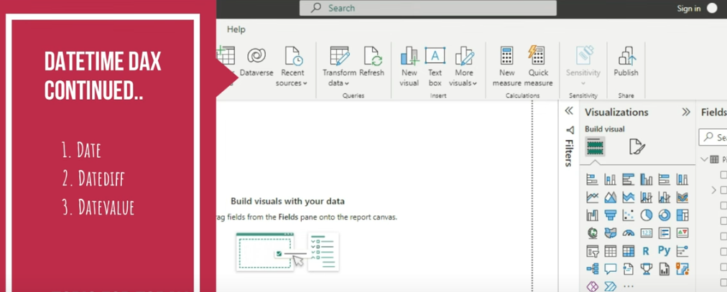

Slide 44


Slide 45
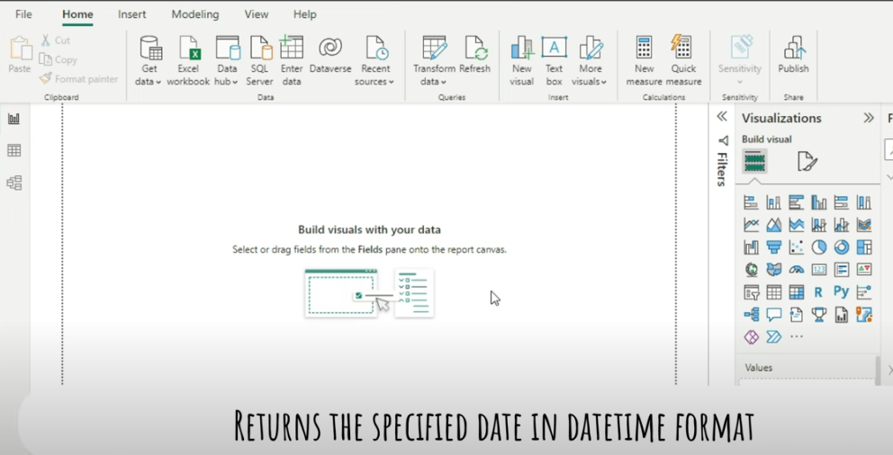

Slide 46
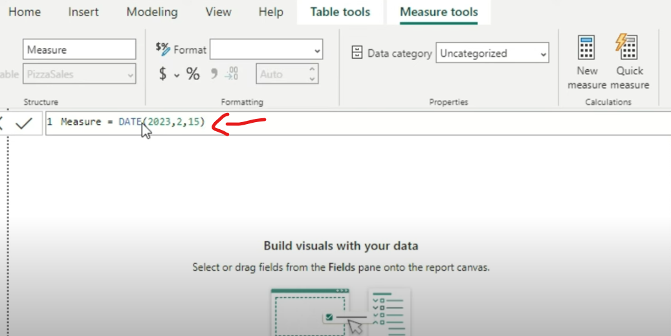
Provide Formula “DATE(Year, Month, Date)”

Slide 47
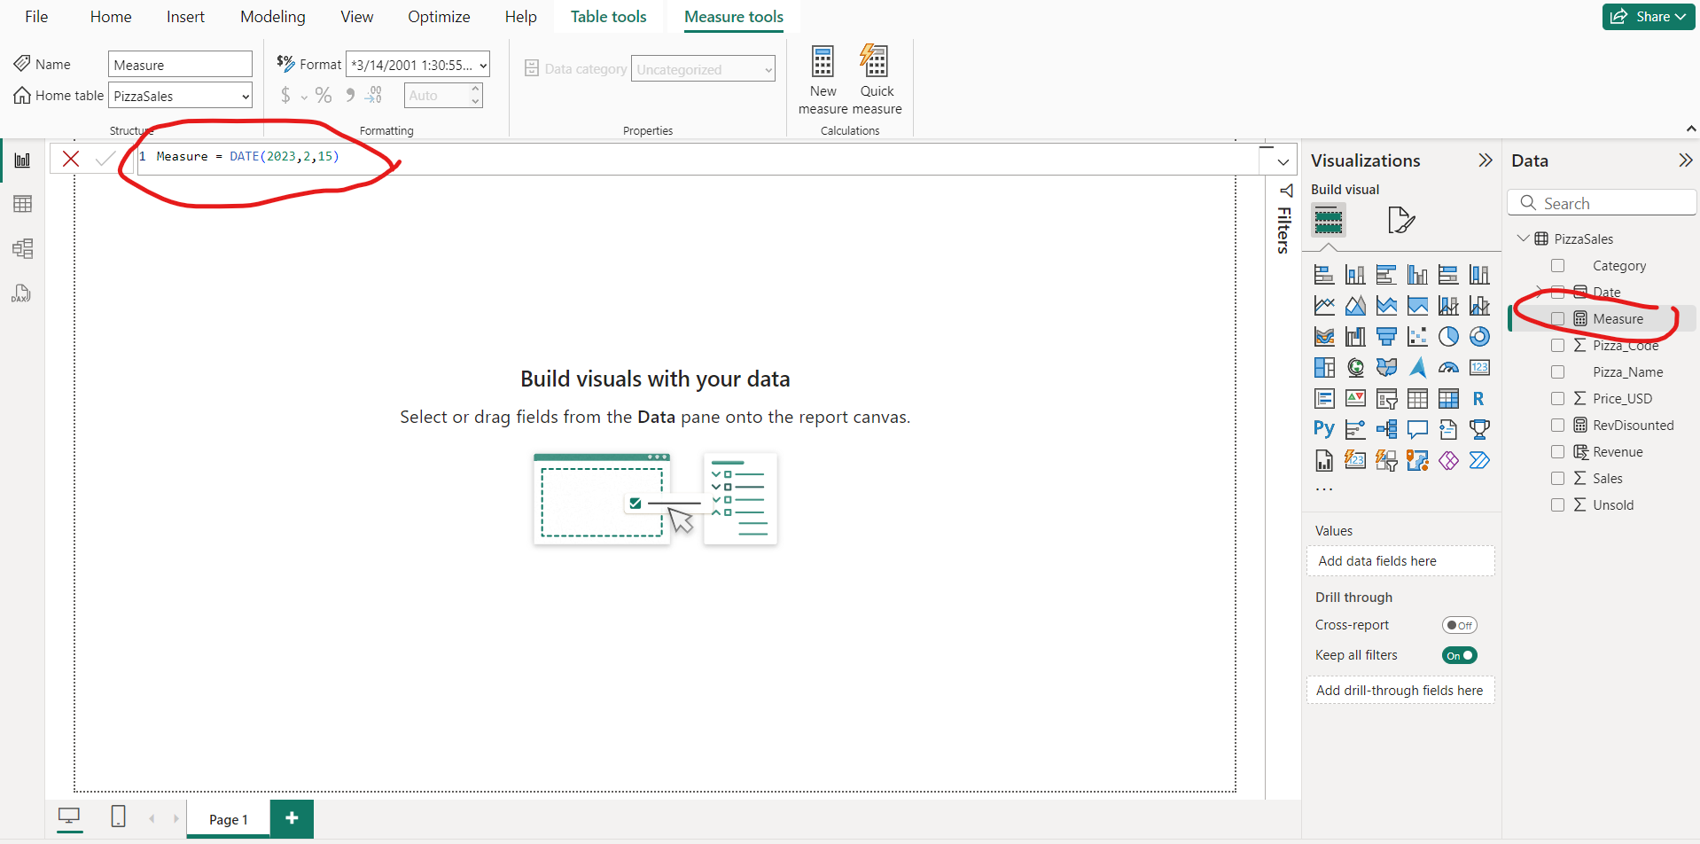
Press Enter Measure is created

Slide 48
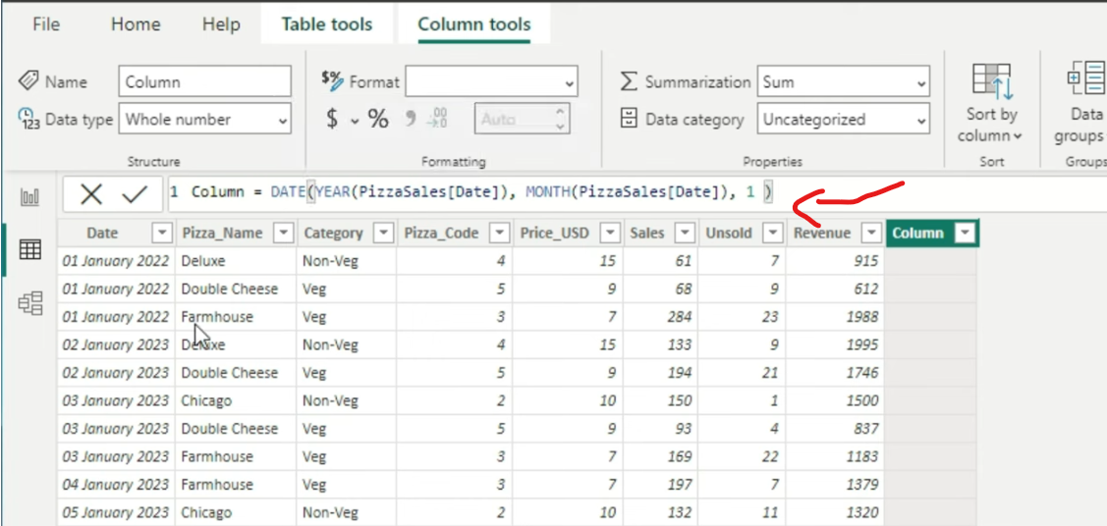

Slide 49
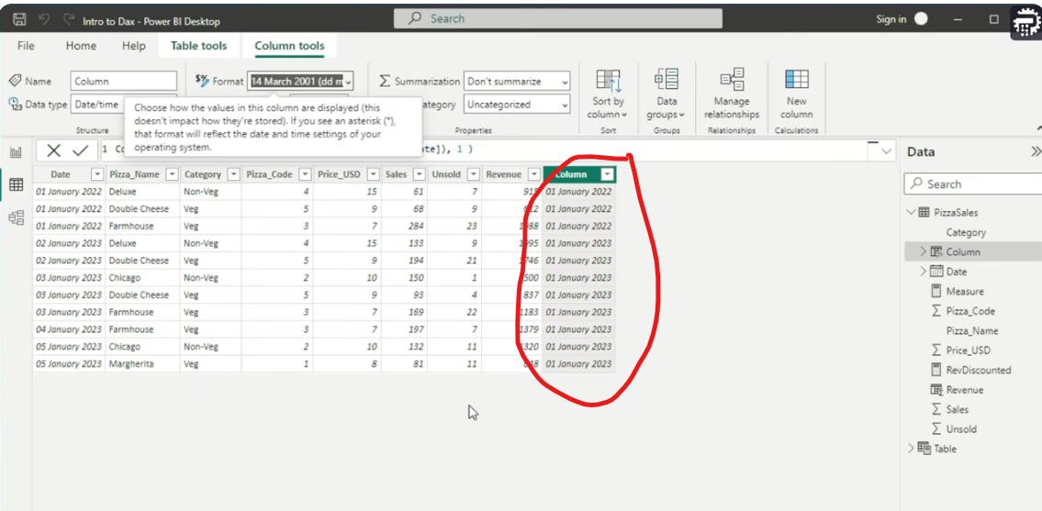
Gives 1st and 1st month of whatever year we have

Slide 50


Slide 51
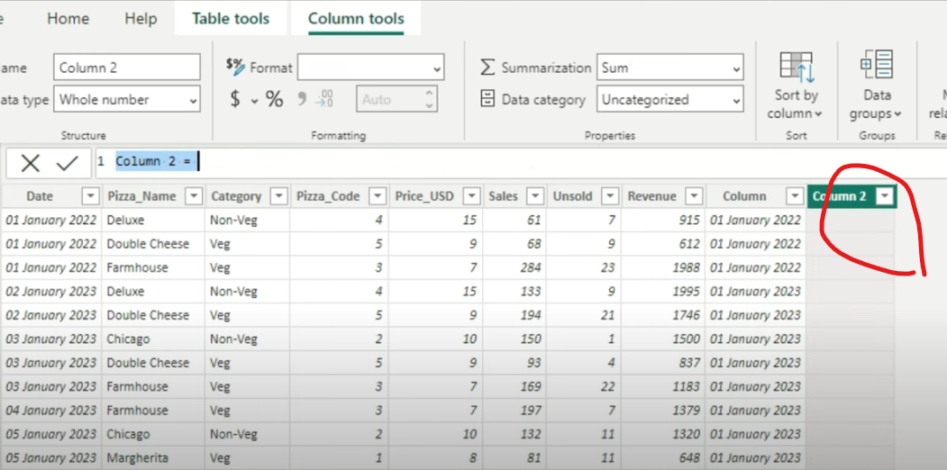
Create a new Column

Slide 52
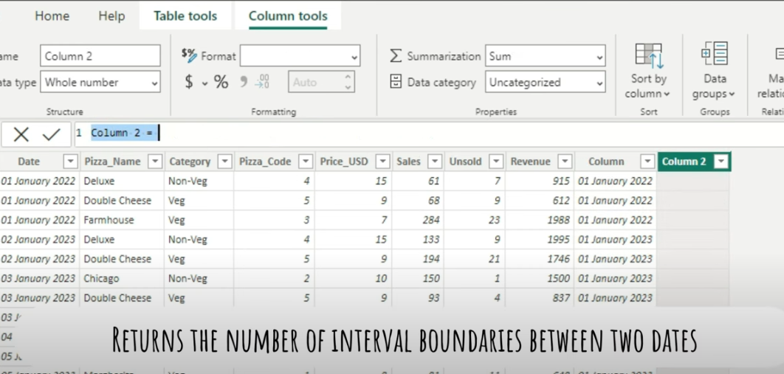

Slide 53
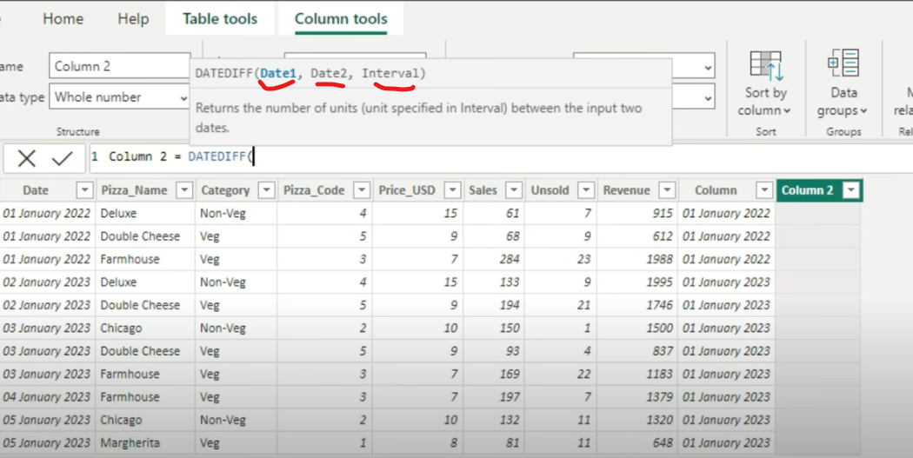
DateDiff

Slide 54
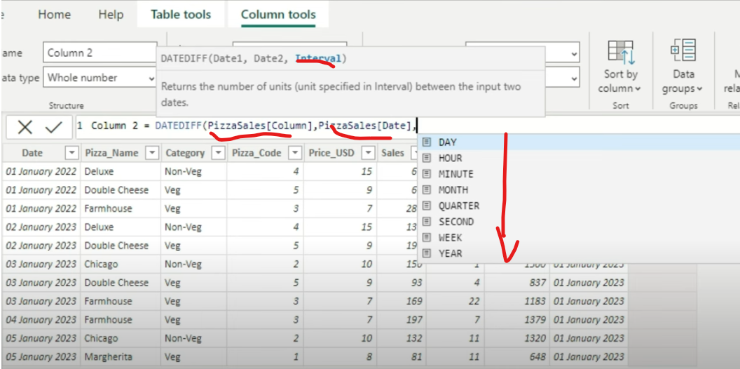
Select Interval between Two date to be either “Days, Hours or Minutes”

Slide 55
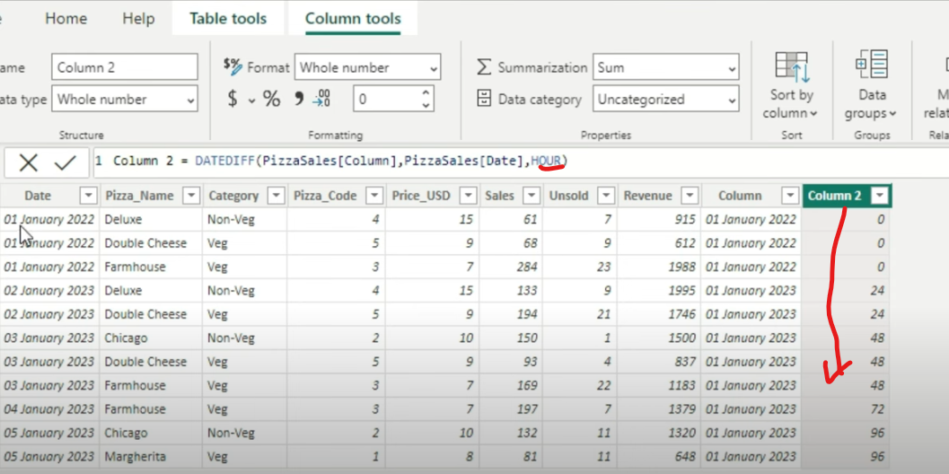
Press enter and DateDiff based column 2 would be created

Slide 56
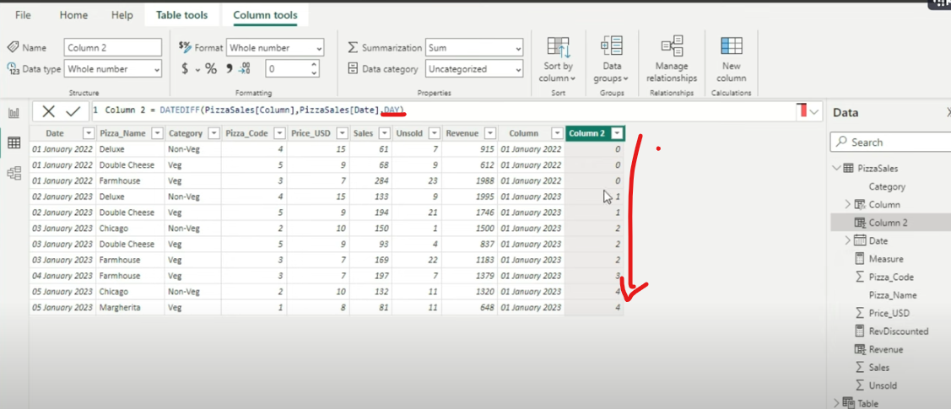
Convert the nterval into “Days” and see what happens

Slide 57


Slide 58
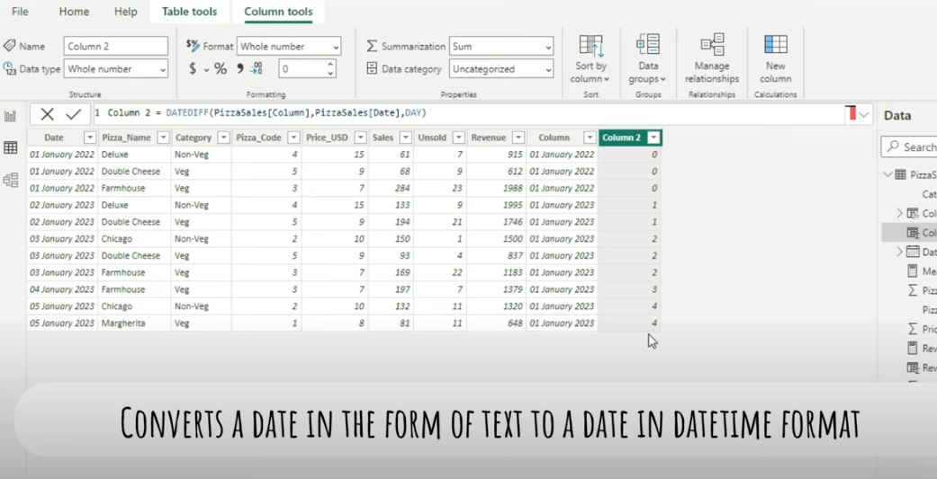

Slide 59
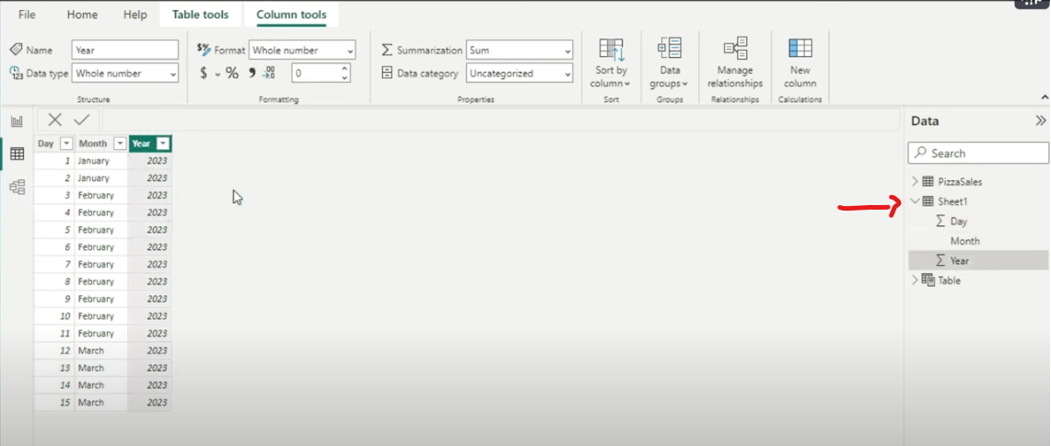
Load sheet 1 dataset

Slide 60
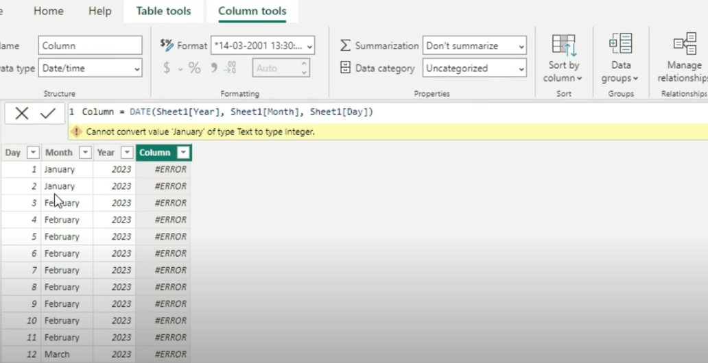
If you try an additional column, Data function cannot Month into text

Slide 61
To remove error Use Datevalue Function

Slide 62
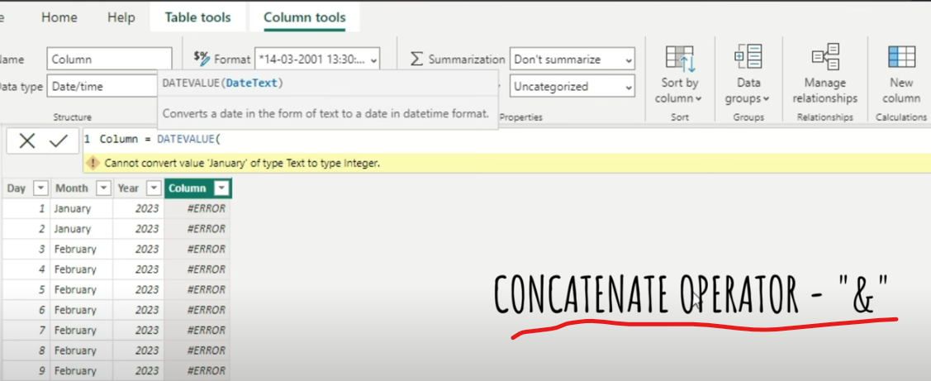
Use DATEVALUE function

Slide 63
